Slide 1

Predictive Power: Harnessing AI to Forecast Anemia Outcomes
Vandit Bhimani
Radhika Khurana

Slide 2

Agenda
Understanding Anemia and Dataset Dynamics
Objective: Precision Anemia Prediction
Model Efficacy: A Comparative Analysis
Decoding Anemia: The AI Algorithmic Approach
Monetary Value
AI in Anemia Detection: Balancing Risks and Benefits
Conclusion and Recommendations

Slide 3

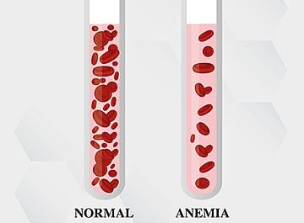
Understanding Anemia and Dataset Dynamics
Anemia is a condition where you lack enough healthy red blood cells to carry adequate oxygen to your body's tissues.
The dataset used for building this model is available on Kaggle and it consists of a total of 1422 observations. In this dataset, the attributes include Gender (coded as 0 for male and 1 for female), along with crucial hematological indicators such as Hemoglobin, MCHC (mean corpuscular hemoglobin concentration), MCV (mean corpuscular volume), and MCH (mean corpuscular hemoglobin).

Slide 4

Objective: Precision Anemia Prediction
Early Detection: To identify anemia at its earliest stages, enabling prompt and effective treatment.
Personalized Treatment Plans: To assist in creating tailored treatment strategies based on individual patient profiles.
Healthcare Efficiency: To streamline diagnostic processes, reducing time and resources spent on conventional testing methods.
Risk Assessment: To predict potential anemia risk in patients, aiding in preventive healthcare measures.

Slide 5
Model Efficacy: A Comparative Analysis
In Our Model, we have compared the Logistic Regression Model, Support Vector Machine (SVM) Model, and K-Nearest Neighbors (KNN) Model
Logistic Regression Model | Support Vector Machine (SVM) Model | K-Nearest Neighbors (KNN) Model
Accuracy: 99.06% | Accuracy: 99.06%, comparable to Logistic Regression | Accuracy: 96.49%, slightly lower than others
Consistent cross-validation scores: Model stability | Slight variance in cross-validation, average score: 0.9887 | Average cross-validation score: 0.9592
Precision: 1.00 (non-anemic), 0.98 (anemic) | Identical precision and recall to Logistic Regression | Lower precision and recall: Higher misclassification tendency

Slide 6

Model Efficacy: A Comparative Analysis Contd.
Comparative Analysis:
Logistic Regression & SVM: High Precision & Recall
Superior Performance in Anemia Prediction
Resistant to Overfitting; Robust across Data Folds
KNN: Effective but Higher Misclassification Rate
Importance of Model Choice: Complexity, Interpretability, Efficiency
Conclusion:
Logistic Regression & SVM: Highly Effective & Reliable
Outperform KNN in Key Metrics
Suitable for High-Stakes Clinical Applications
KNN's Underperformance Highlights Model Trade-offs
Need for a Balanced Approach in Model Selection: Considering Complexity, Interpretability, Real-World Applicability

Slide 7
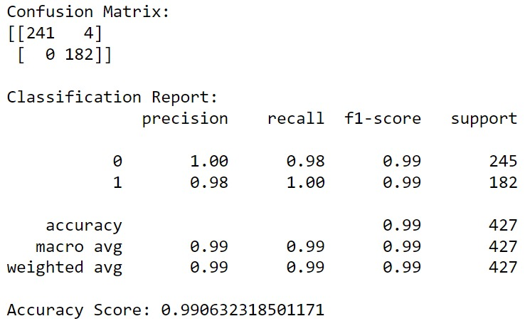
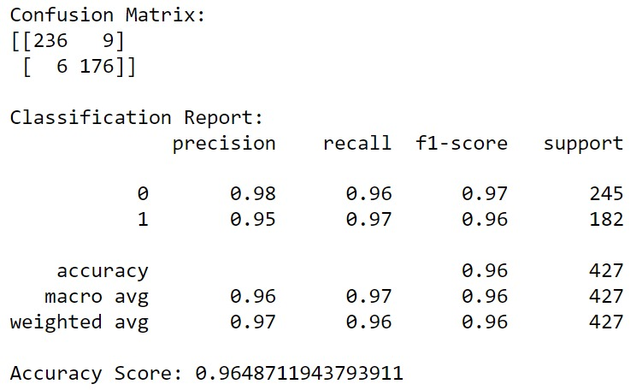
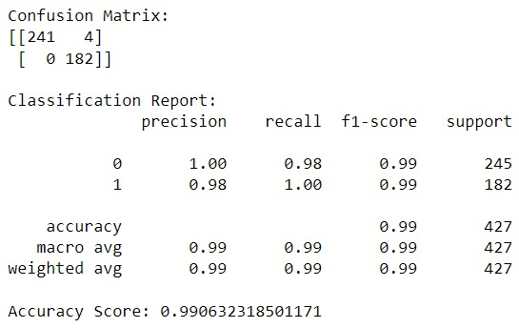
Outputs from the models:
Support Vector Machine (SVM) Model
K-Nearest Neighbors (KNN) Model
Logistic Regression

Slide 8
Decoding Anemia: The AI Algorithmic Approach
1. Exploratory Data Analysis (EDA)
2. Feature Engineering
3. Data Preparation
4. Data Modeling
5. Evaluating Model on different Parameters

Slide 9
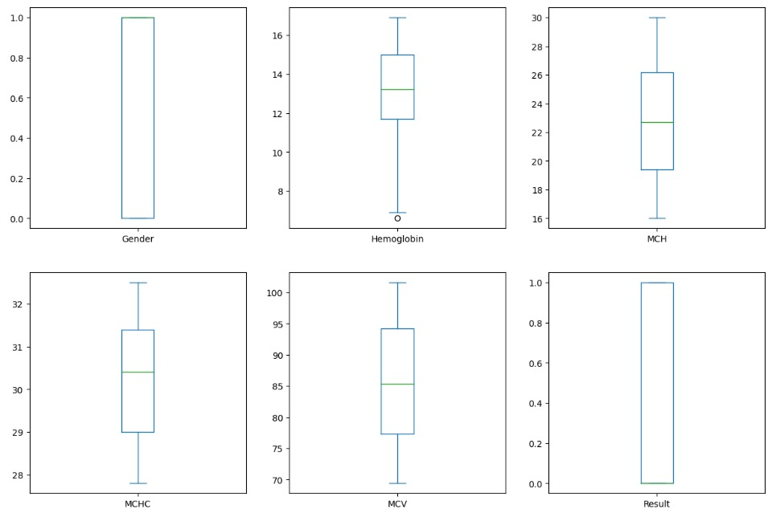
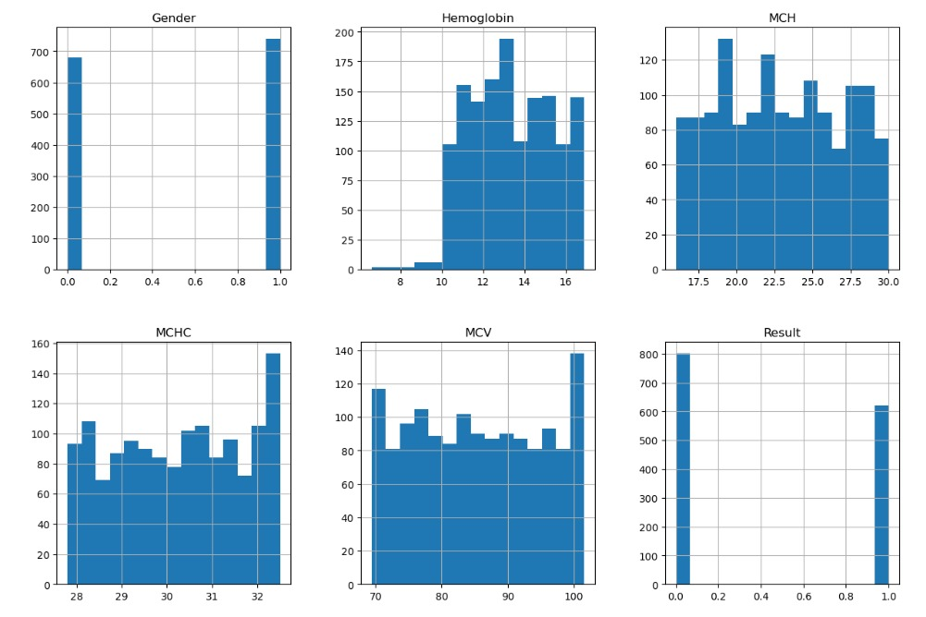
Exploratory Data Analysis (EDA)
Outliers
Data Distribution and Skewness
There were outliers in the Hemoglobin column, and we applied the Interquartile Range (IQR) method to remove them.
Gender 0.083200
Hemoglobin 0.022746
MCH 0.046294
MCHC 0.077379
MCV 0.032054
Result 0.257114

Slide 10
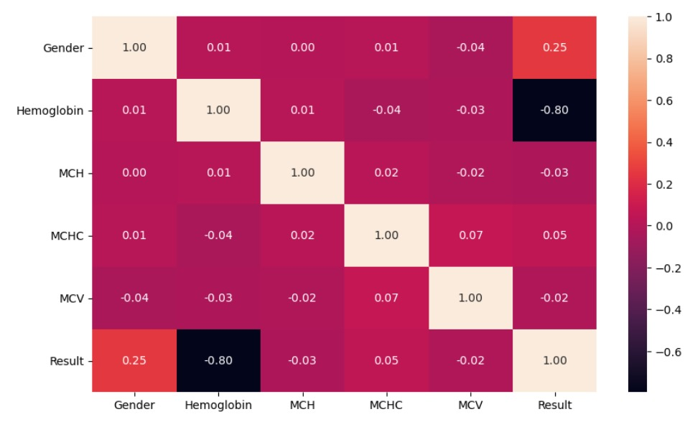
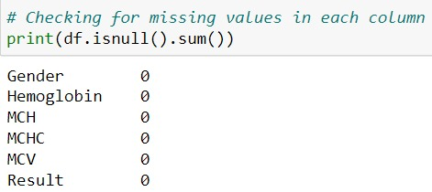
Exploratory Data Analysis (EDA) Contd.
Missing Values
Correlation
There were no missing values in our dataset. If missing value there then replace median.

Slide 11


Exploratory Data Analysis (EDA) Contd.
Comparison between patients
Our dataset was complete with no missing values. However, should any missing values arise, our strategy is to replace them with the median value to maintain data integrity and consistency.
Where 0=non-anemia and 1=anemia

Slide 12

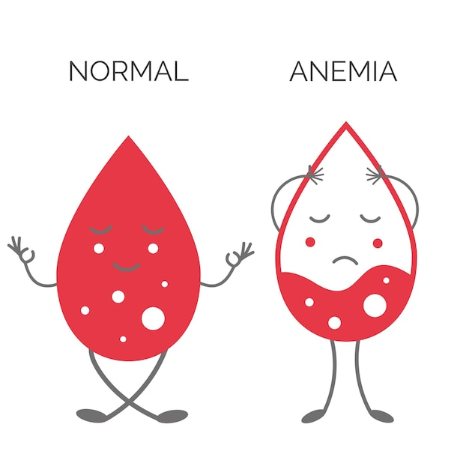

Monetary Value
1. Economic Advantages of Early Intervention:
Substantial cost reduction by averting progression to severe anemia.
Decreased expenses on extensive treatments and hospital stays.
2. Enhanced Healthcare Efficiency:
Strategic use of medical resources through AI-guided interventions.
Minimization of redundant testing and treatments, leading to cost-effectiveness.
3. Minimizing Health Complications:
Reduction in long-term medical costs by avoiding severe anemia-related complications.
Significant improvement in life quality for patients through proactive management.

Slide 13



AI in Anemia Detection: Balancing Risks and Benefits
Benefits:
1. Better Patient Outcomes through Early Detection:
Timely intervention enabled by AI leads to improved health results.
Prompt treatment initiation following early diagnosis.
2. Enhancing Cost-Efficiency:
Reduction in overall healthcare spending via streamlined processes.
Decreased reliance on unnecessary diagnostic procedures and treatments.
3. Advancing Population Health Management:
AI assists in discerning anemia trends at the population level.
Facilitates focused public health strategies and interventions.
4. Boosting Medical Research:
Utilization of de-identified data from the AI model for research.
Enriches understanding of anemia and associated health conditions.

Slide 14
AI in Anemia Detection: Balancing Risks and Benefits
Risks:
1. Upholding Patient Data Security:
Prioritizing data privacy in handling sensitive patient information.
Compliance with Canadian healthcare regulations for data protection.
Building patient trust through robust security measures.
2. Seamless Workflow Integration:
Necessity of fitting AI into existing healthcare systems.
Addressing change resistance, staff training, and integration challenges.
Ensuring the AI model enhances rather than disrupts medical processes.
3. Addressing Ethical Concerns:
Focus on mitigating AI bias and ensuring equitable predictions.
Upholding ethical standards in AI application in healthcare.
Commitment to fair and unbiased healthcare outcomes.
4. Regulatory Compliance:
Adherence to Health Canada regulations and guidelines.
Ensuring the AI model meets all legal and regulatory requirements.
Prioritizing regulatory compliance in AI model development and deployment.

Slide 15

Conclusion
We've seen how AI models like Logistic Regression, SVM, and KNN can effectively predict anemia, with high accuracy and reliability.
The implementation of these AI models offers significant advantages, including early detection, cost-efficiency, improved patient outcomes, and valuable insights for population health management.
However, successful deployment requires careful consideration of patient data security, ethical standards, workflow integration, and adherence to regulatory guidelines, particularly within the Canadian healthcare context.
This initiative not only stands to revolutionize anemia diagnosis but also paves the way for broader applications of AI in healthcare, promising a future where technology and medicine converge to enhance patient care and treatment efficacy.

Slide 16

Recommendations:
1. Enhance Data Security and Privacy Measures:
Invest in robust cybersecurity infrastructure to protect patient data.
Regularly update and audit security protocols to comply with Canadian healthcare privacy regulations.
Educate healthcare staff on data privacy best practices.
2. Promote Interdisciplinary Collaboration:
Foster partnerships between AI technologists, healthcare professionals, and policymakers.
Encourage collaborative efforts for continuous improvement of the AI model, focusing on accuracy and ethical considerations.
Utilize feedback from medical staff and patients to refine the AI system.
3. Continuously Monitor and Update AI Algorithms:
Implement ongoing monitoring to ensure the accuracy and fairness of the AI model.
Regularly update the algorithm based on new medical research and patient data.
Stay adaptable to emerging trends and advancements in AI and healthcare technology.

Slide 17


THANK YOU
Vandit Bhimani
Radhika Khurana

